Slide 1

Question Pairs
Sukanya Behera [160714733008]
Chandrabhatta Sriram [160713733042]
Abul Faiz Mohammed Abdul Hadi Mouzzam [160714733108]
Project Guide: E. Shailaja [Asst. Prof. Dept. of CSE]
Project Co-ordinator: R. Sandeep [Asst. Prof. Dept. of CSE]
Methodist College of Engineering & Technology

Slide 2
Introduction [Problem Definition]
More formally, the duplicate question detection problem can be defined as follows: given a pair of questions q1 and q2, train a model that learns the function:
f(q1, q2) → 0 or 1.
where 1 represents that q1 and q2 have the same intent and 0 otherwise.
NOTE: q1 and q2 are given as string data.

Slide 3
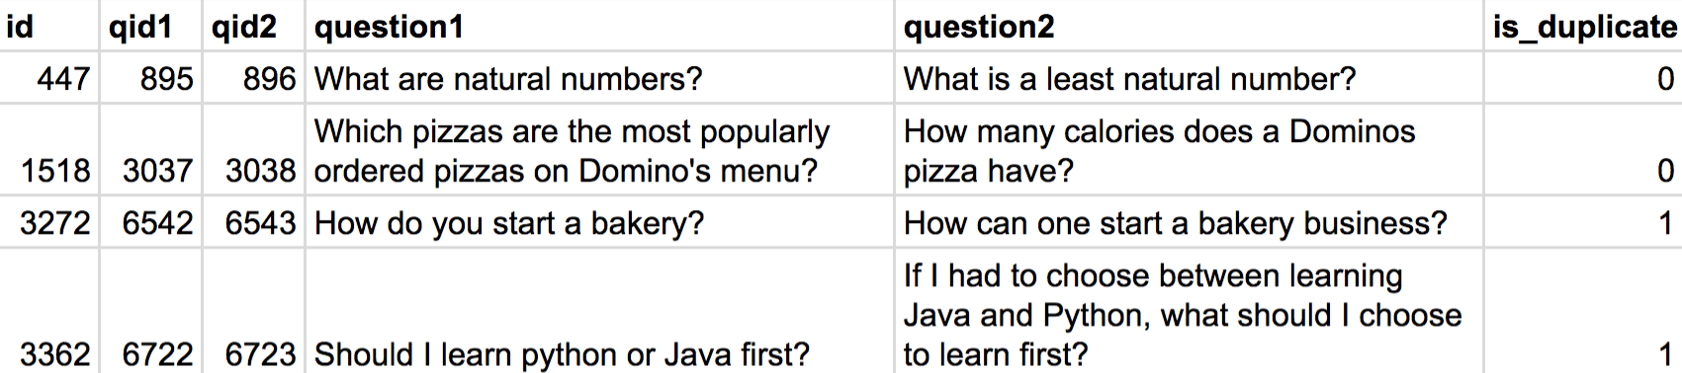
Problem Input [test.csv]

Slide 4
Problem Output [Expected]

Slide 5
Modules
Text Pre-processing: text tokenization, uniform text casing, stop word removal, lemmatization, stemming, etc.
Featurization / Vectorization of the texts [q1 and q2]: Convert the given q1 and q2 into Word Vectors using word2vec. Word vectors are positioned in the vector space such that words that share common contexts in the corpus are located in close proximity to one another in the space.
Apply a Machine Learning Model [using k – Nearest Neighbours algorithm] to get the Expected Output.

Slide 6
Data Flow Diagram – Level 0

Slide 7
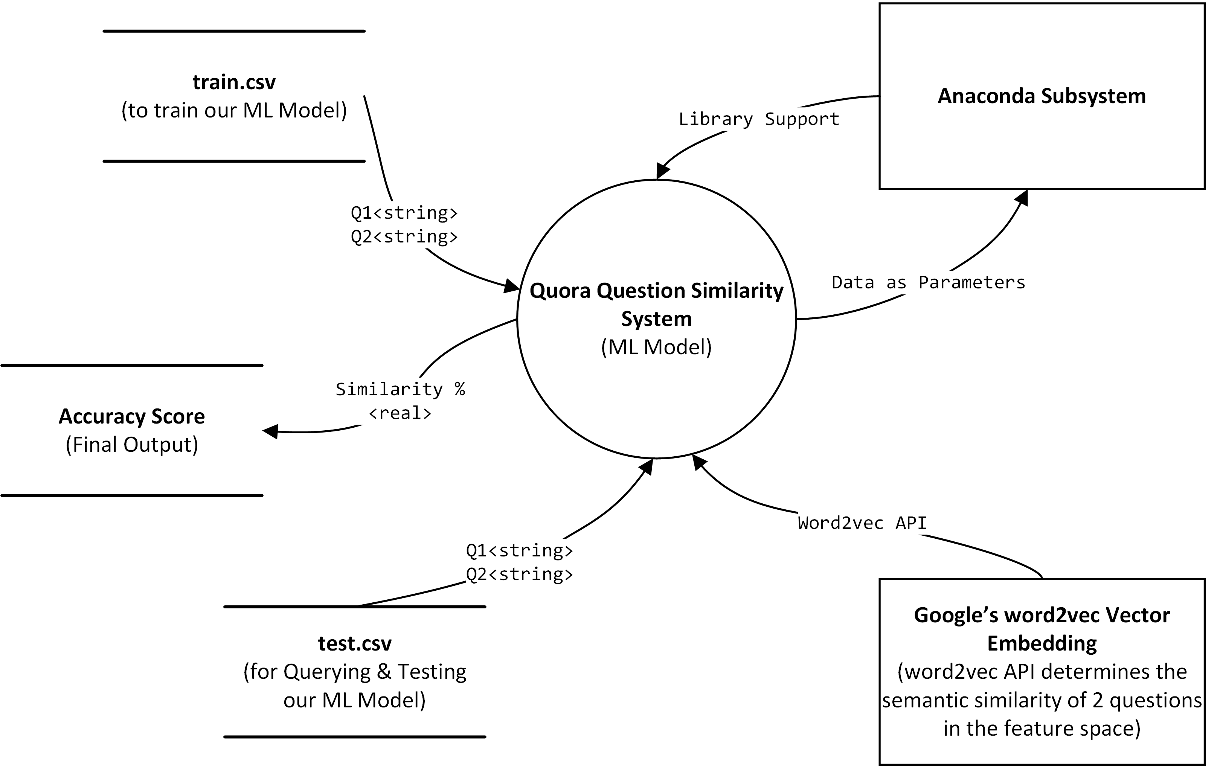

Slide 8
Data Flow Diagram – Level 1 Quora Question Similarity System

Slide 9
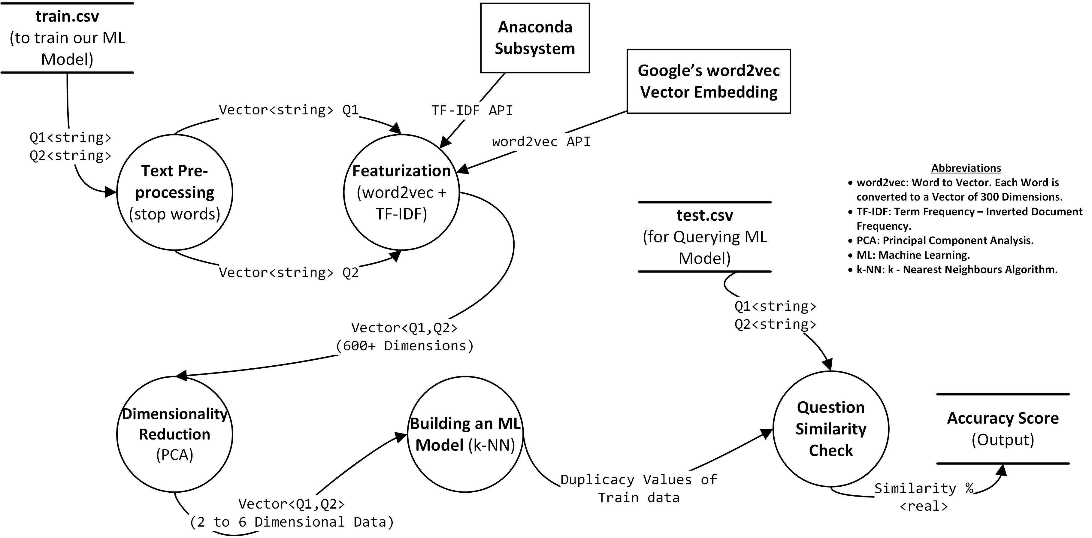

Slide 10
Use Case Diagram – 1 [Question Posting]

Slide 12
Use Case Diagram – 2 [Question Search]

Slide 14
Sequence Diagram

Slide 15
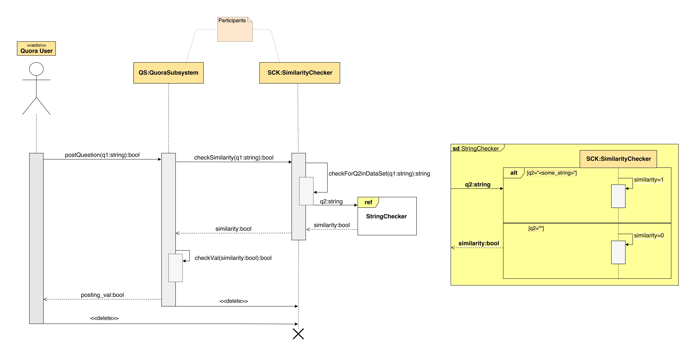

Slide 16
Deployment Diagram

Slide 17
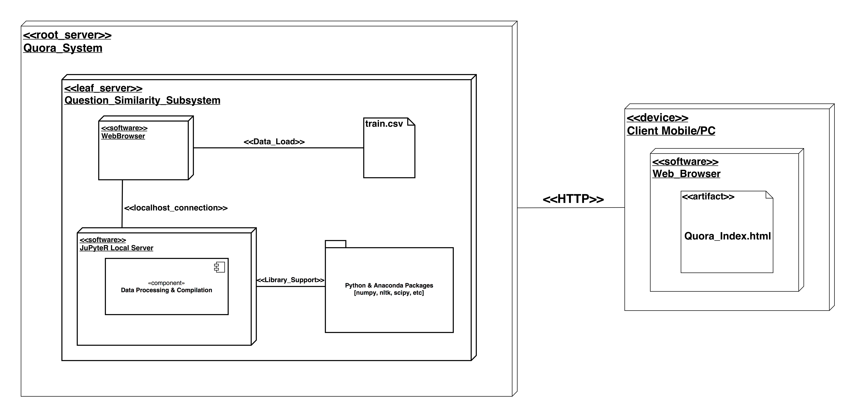

Slide 18
Algorithm Information
In k-NN classification, the output is a class membership. An object is classified by a majority vote of its neighbours, with the object being assigned to the class most common among its k nearest neighbours (k is a positive integer, typically small). If k = 1, then the object is simply assigned to the class of that single nearest neighbour.
Distance between 2 points in the feature space, can be found by taking Euclidean Distance.

Slide 19
Thank You!

Slide 20
Any Questions/Queries?

